Slide 1




Knowledge Session - Project Phase 5 & 6
Experiential Learning
SmartBridge | info@thesmartbridge.com

Slide 2


Agenda
Coding & Solutioning
Performance Testing
Github

Slide 3
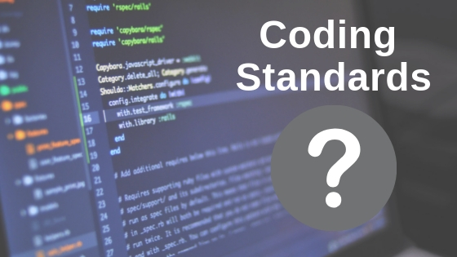
Coding & Solutioning
Coding and solutioning refers to the process of creating a solution to a problem or task using programming languages and tools. This involves writing code, testing and debugging, and optimizing the solution for performance and efficiency.

Slide 4
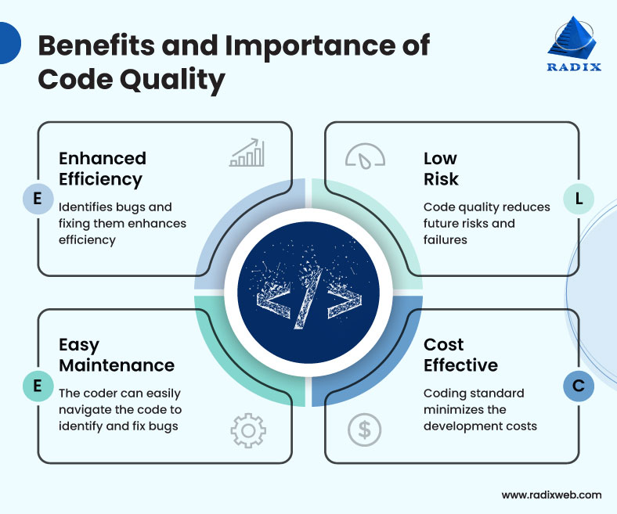
Coding & Solutioning
Source- Radix

Slide 5
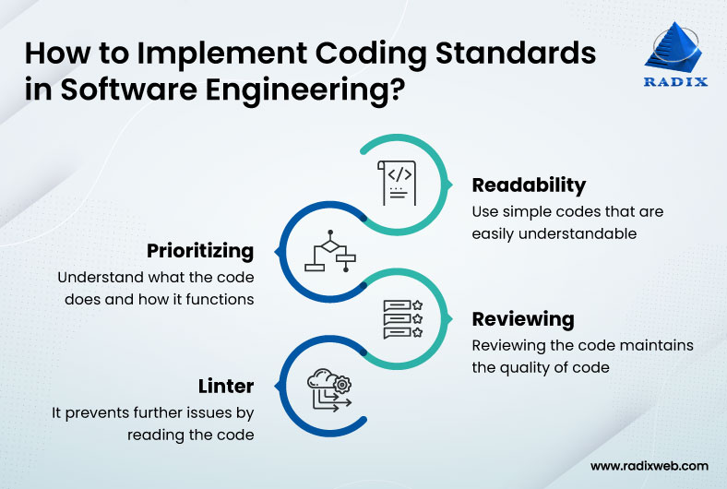
Coding & Solutioning
Source- Radix

Slide 6
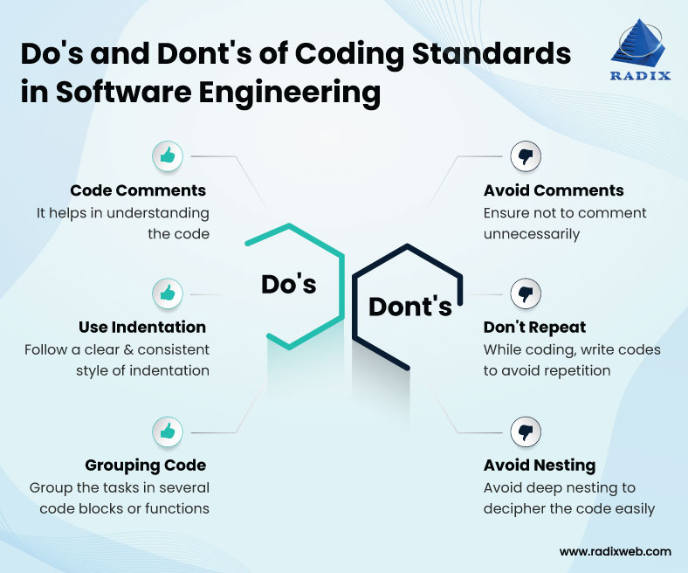
Coding & Solutioning
Source- Radix

Slide 7
Coding & Solutioning
Important parameters of the code:
1. No. of Functional Features 2. Code Efficiency 3. Utilization of algorithms 4. Coding Layout (Self-explanation & reusability) 5. Debugging & Traceability 6. Exception Handling

Slide 8

Performance Testing
Performance testing is a non-functional software testing technique that determines how the stability, speed, scalability, and responsiveness of an application holds up under a given workload. It’s a key step in ensuring software quality, but unfortunately, is often seen as an afterthought, in isolation, and to begin once functional testing is completed, and in most cases, after the code is ready to release.

Slide 9
Need of Performance Testing
To determine whether the application satisfies performance requirements (for instance, the system should handle up to 1,000 concurrent users).
To locate computing bottlenecks within an application.
To establish whether the performance levels claimed by a software vendor are indeed true.
To compare two or more systems and identify the one that performs best.
To measure stability under peak traffic events.

Slide 10
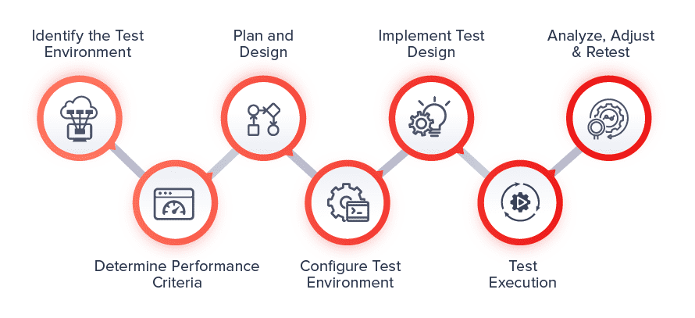
How to do Performance Testing?
Identify the Test Environment and Tools
Define Acceptable Performance Criteria
Plan and Design Tests
Prepare Test Environment and Tools
Run the Performance Tests
Resolve and Retest

Slide 11
Thank You

